Slide 1
Mountains and Rivers of Alaska
Alaska History and Geography

Slide 3
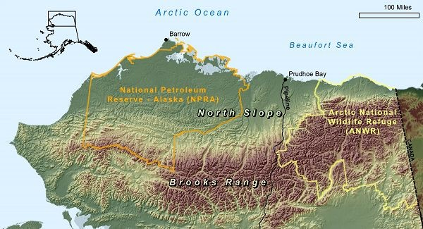

Slide 4
Brooks Range

Slide 5
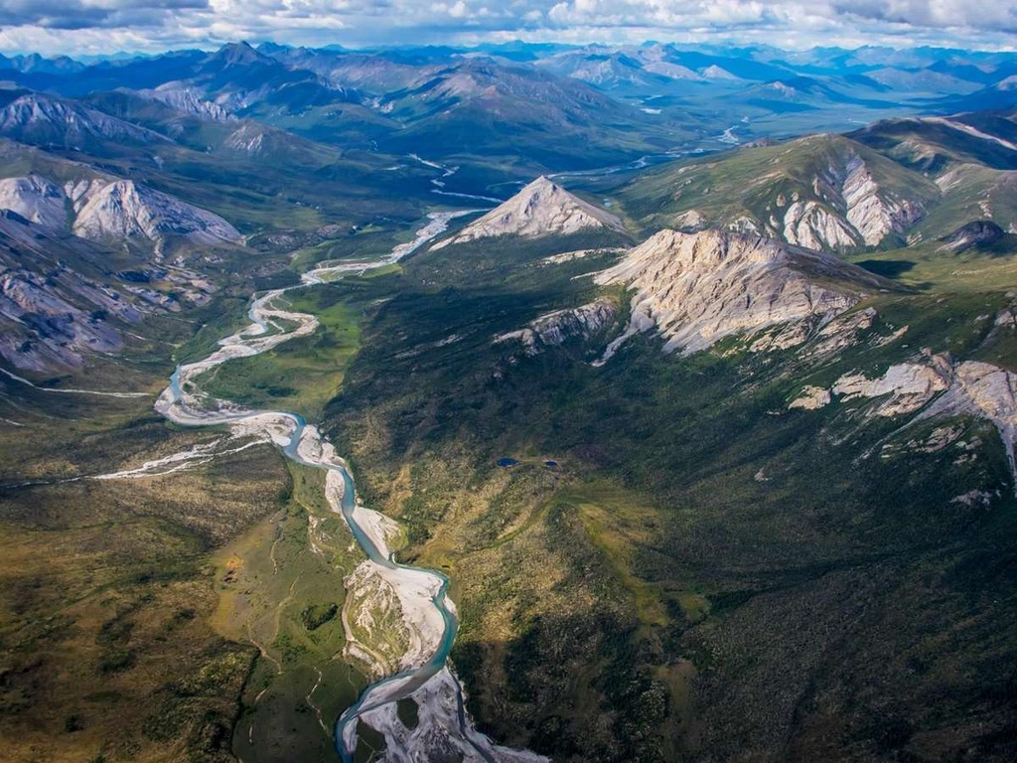

Slide 6
Brooks Range

Slide 7
Brooks Range

Slide 8
Wrangell St. Elias Range

Slide 9
Wrangell St. Elias Mountains

Slide 10
Wrangell St. Elias Range

Slide 11
Wrangell St. Elias Range

Slide 12
Wrangell St Elias Range

Slide 13
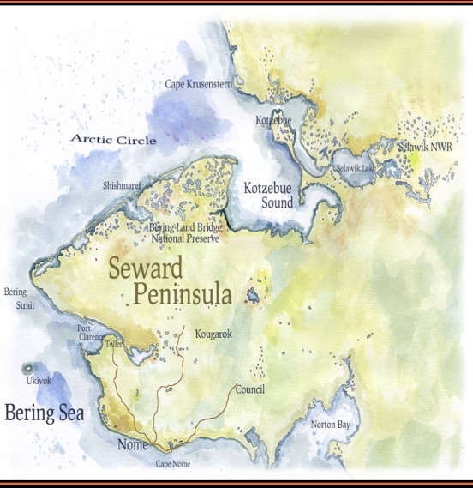

Slide 14
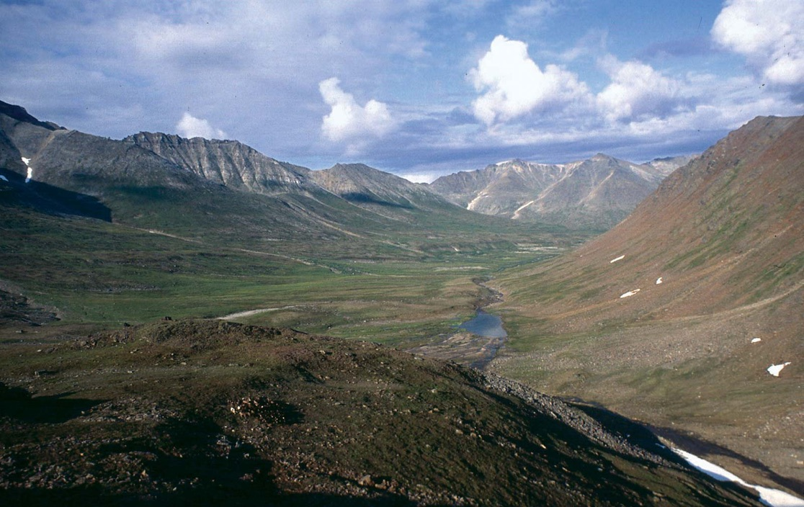

Slide 15
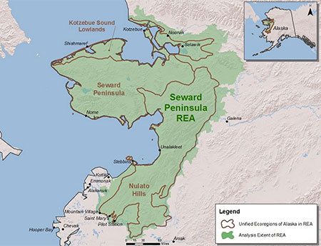

Slide 16
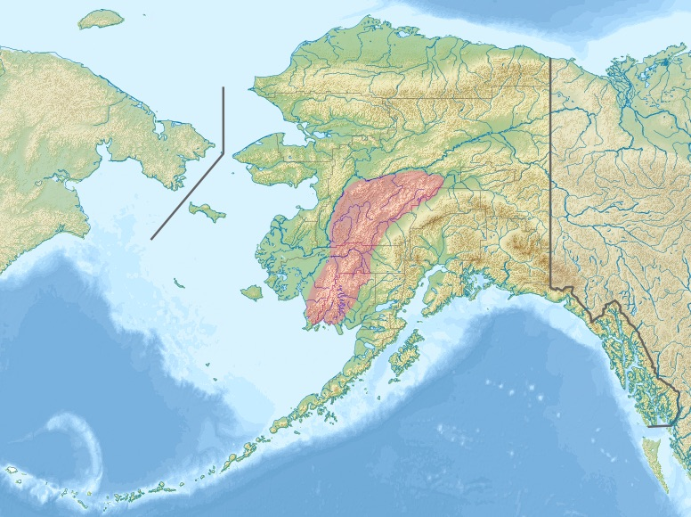
Kuskokwim Mountains

Slide 17
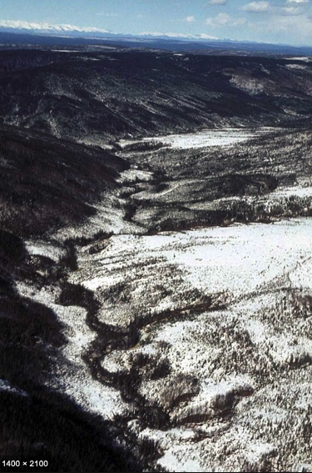
Kuskokwim Mountains and River

Slide 18
Yukon River

Slide 19
Yukon River

Slide 20
YUKON RIVER

Slide 21
Colville River

Slide 22
Colville River

Slide 23
Colville River

Slide 25
Copper River

Slide 26
Chugach Range - Anchorage

Slide 27
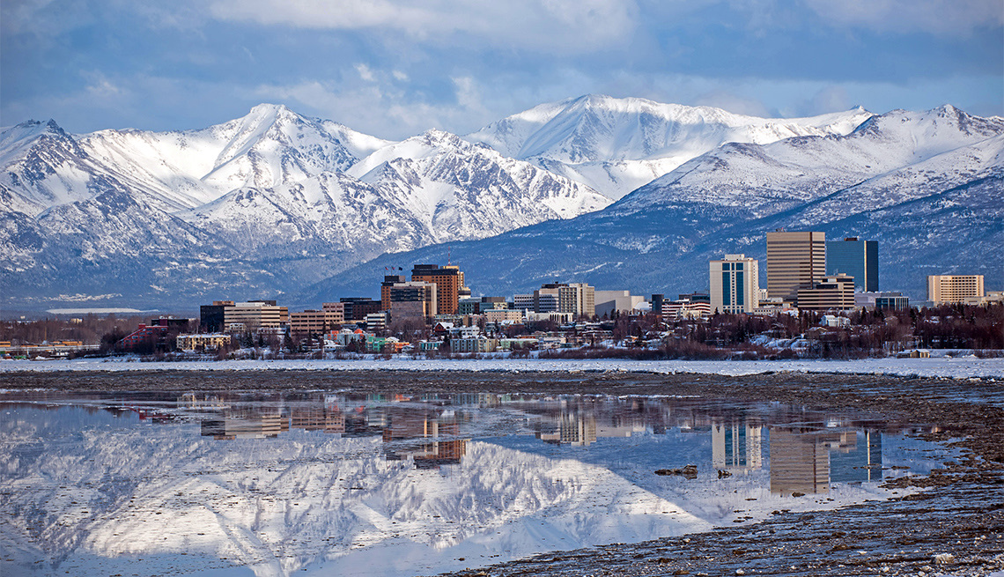

Slide 28
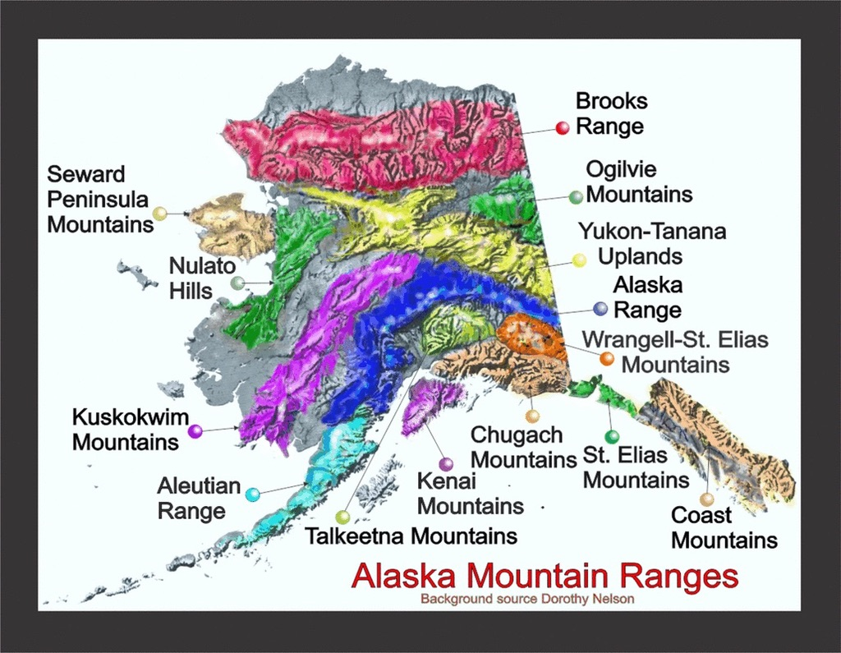

Slide 29
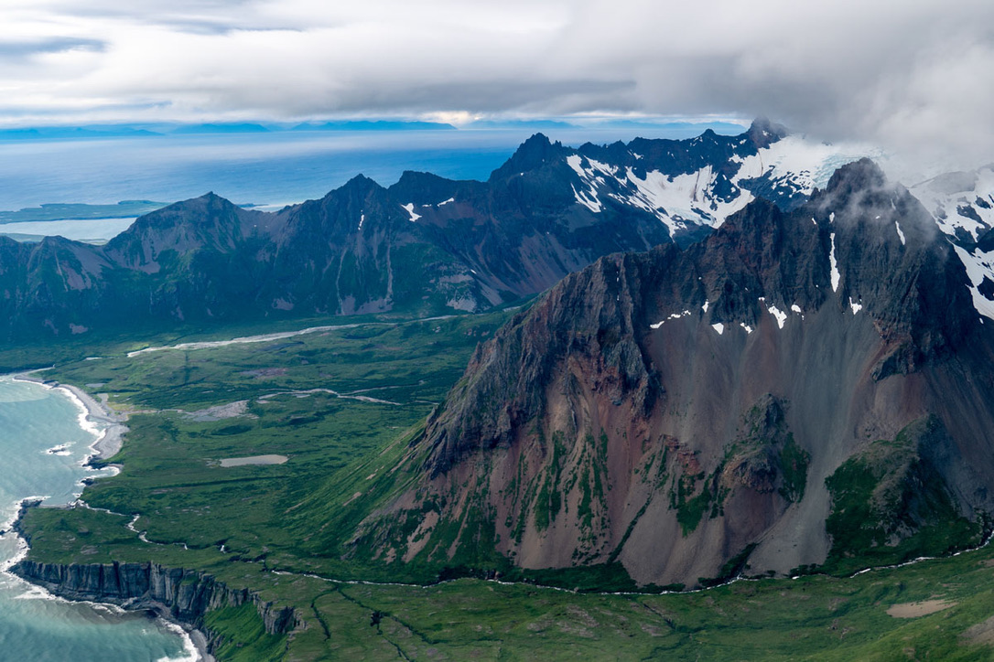
Aleutian Range

Slide 30
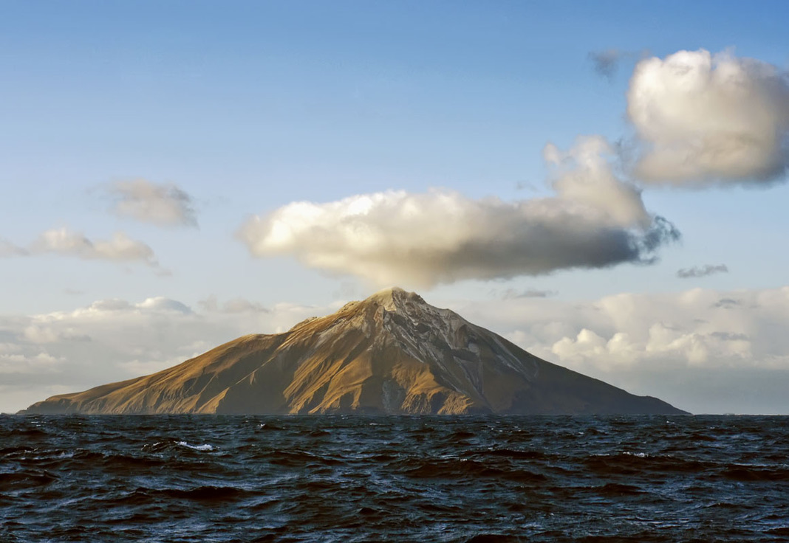

Slide 31
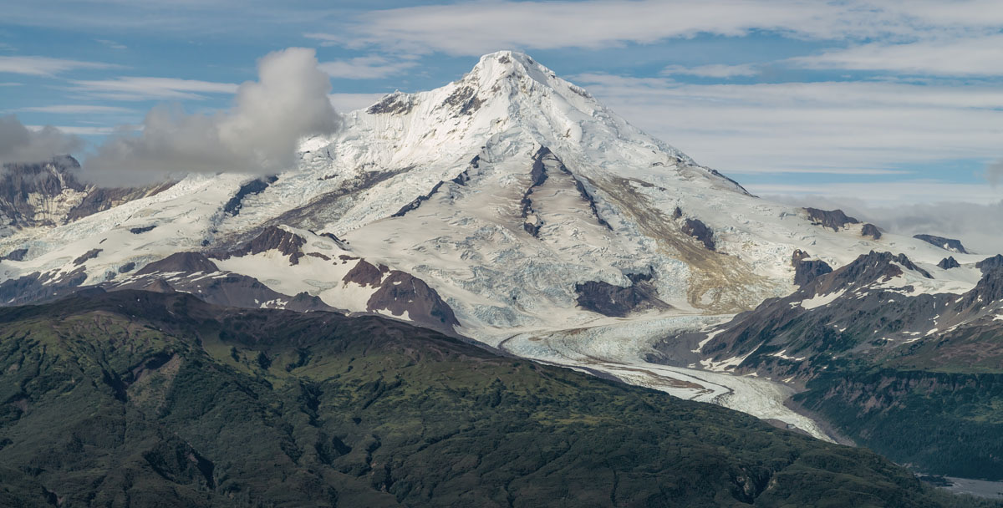

Slide 32
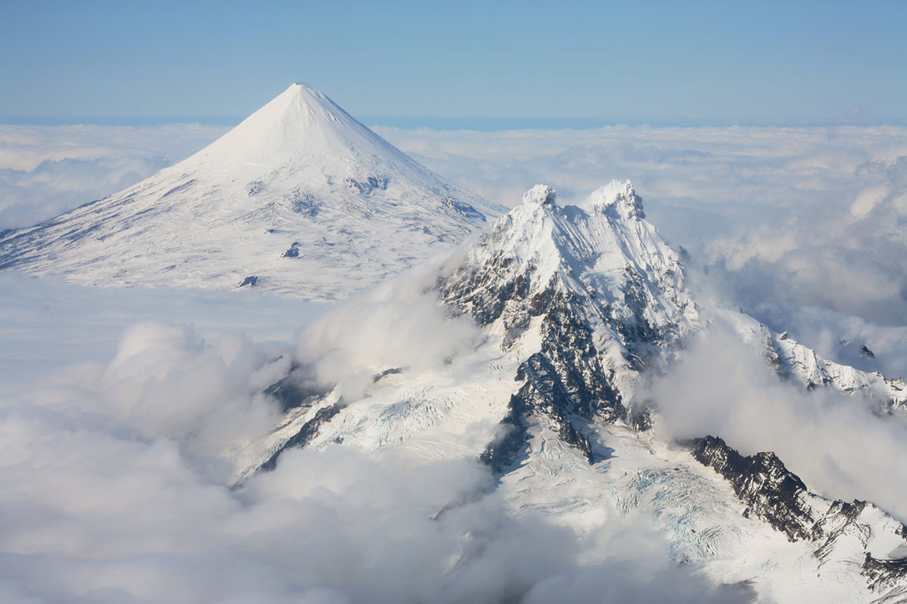

Slide 34
Alaska Range

Slide 39
Media
https://www.nationalgeographic.com/news/2015/09/150901-pictures-denali-mount-mckinley-name-change-alaska/#/01denaliqa.jpg
https://www.youtube.com/watch?v=WJeY2C891cs
https://www.youtube.com/watch?v=8_N7CEwH6hA

Slide 40
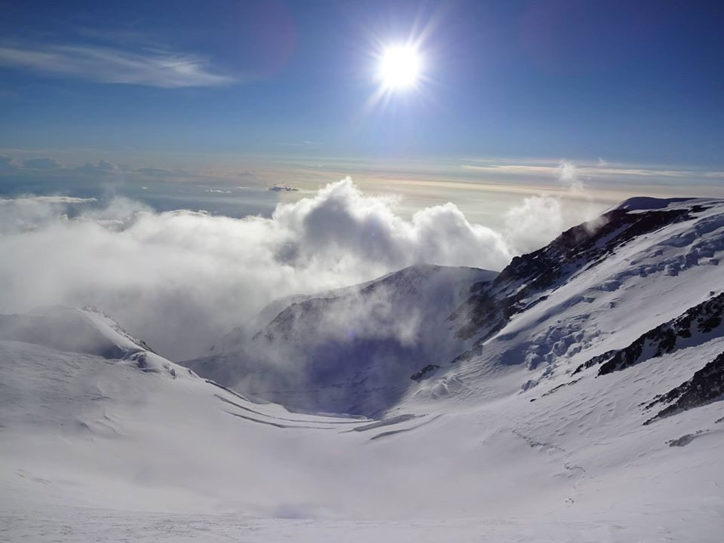

Slide 41
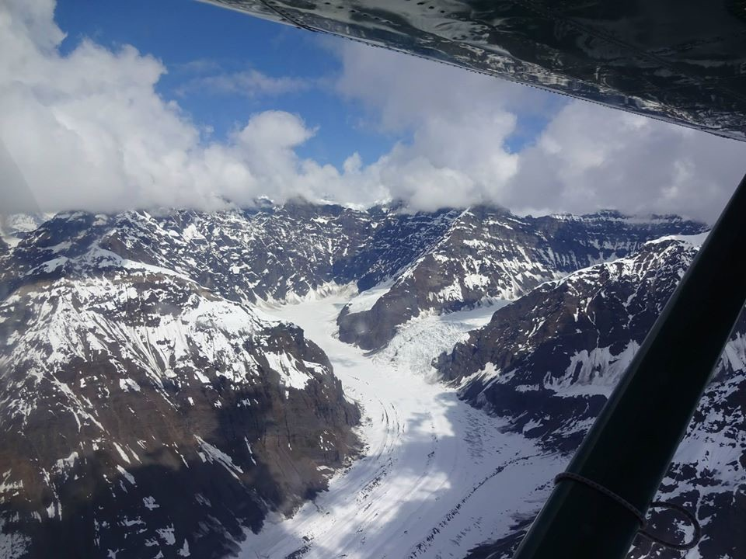

Slide 42
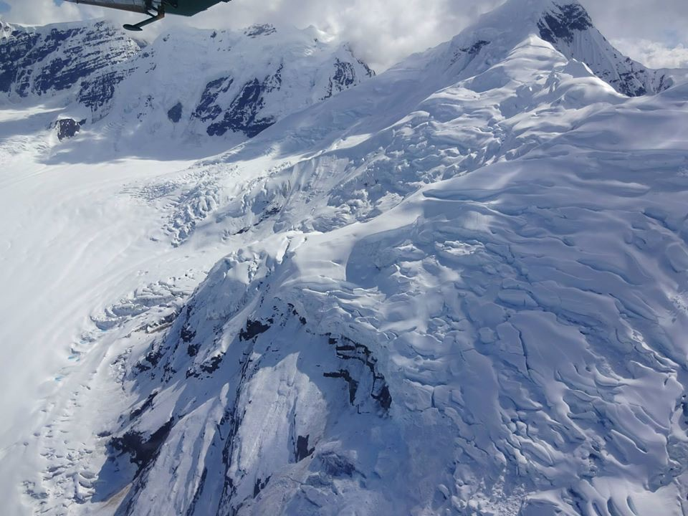

Slide 43
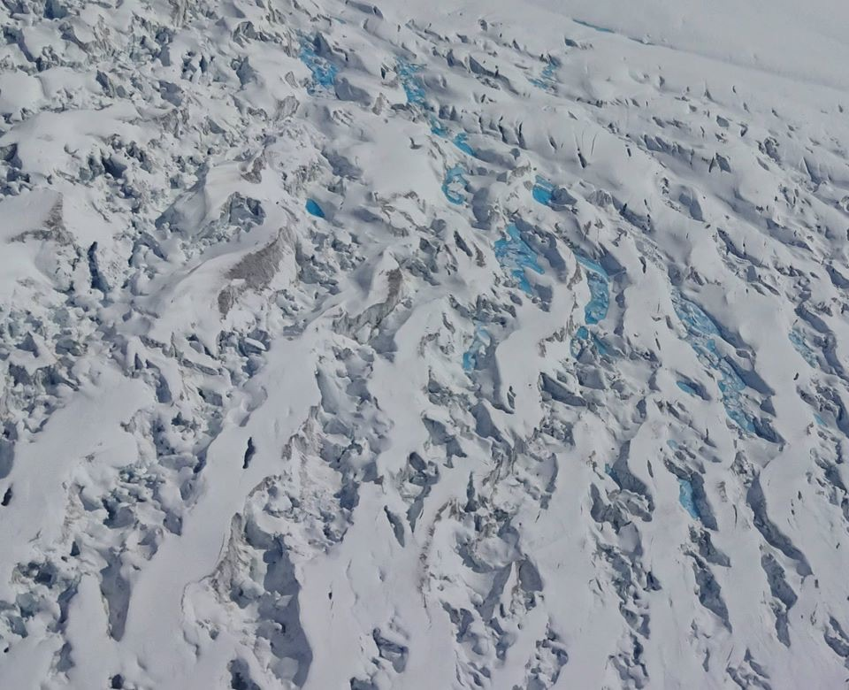

Slide 44
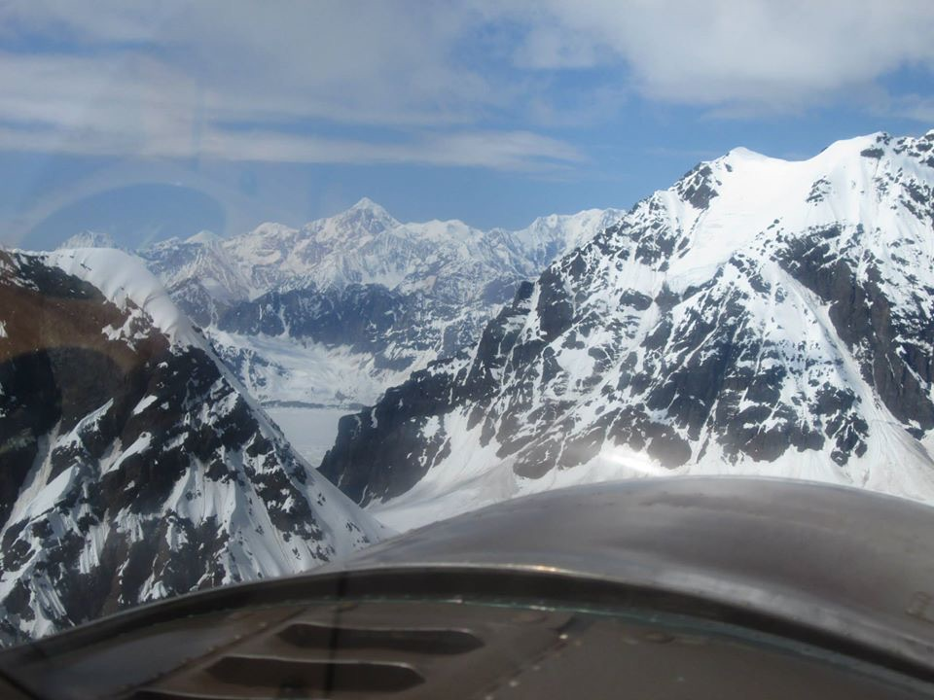

Slide 45
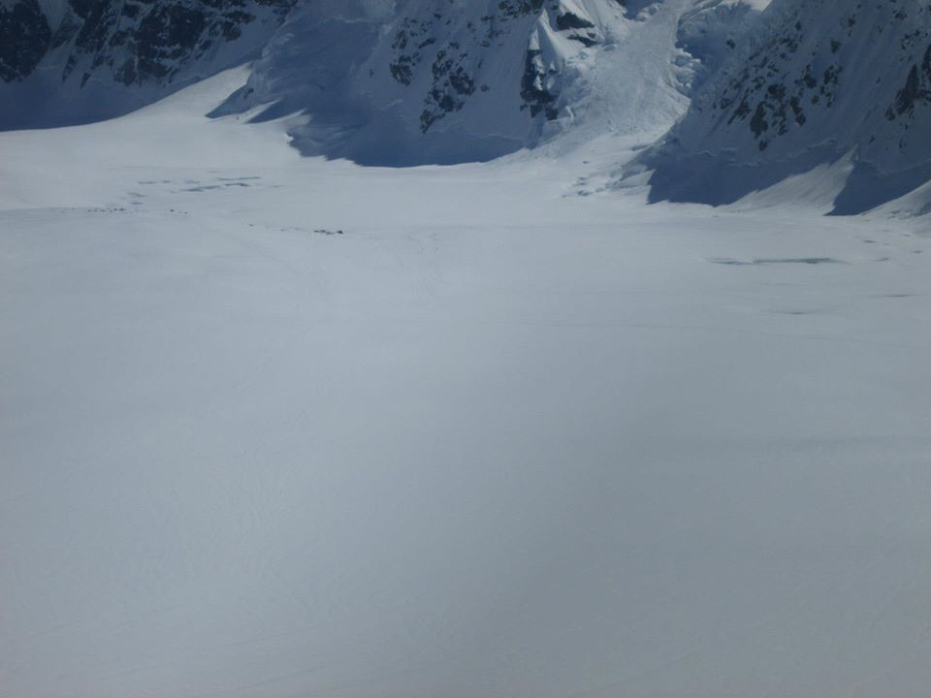

Slide 46
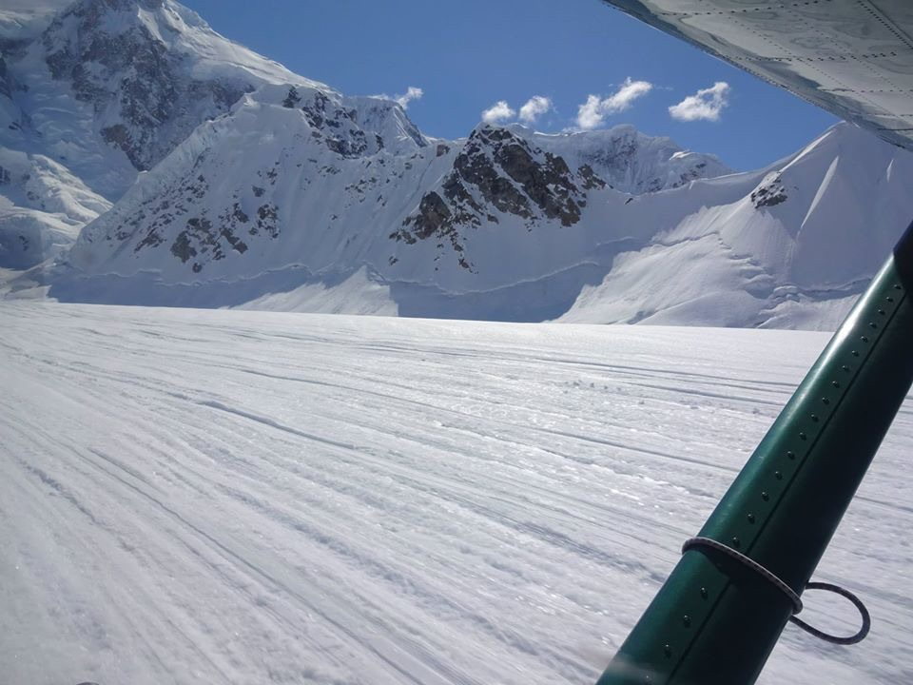

Slide 47
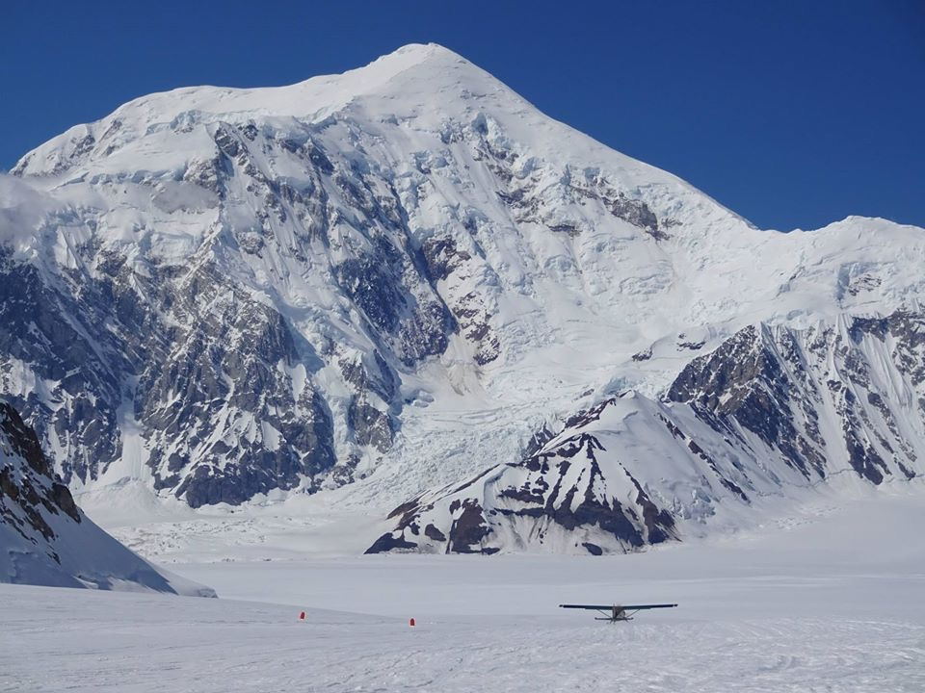

Slide 48
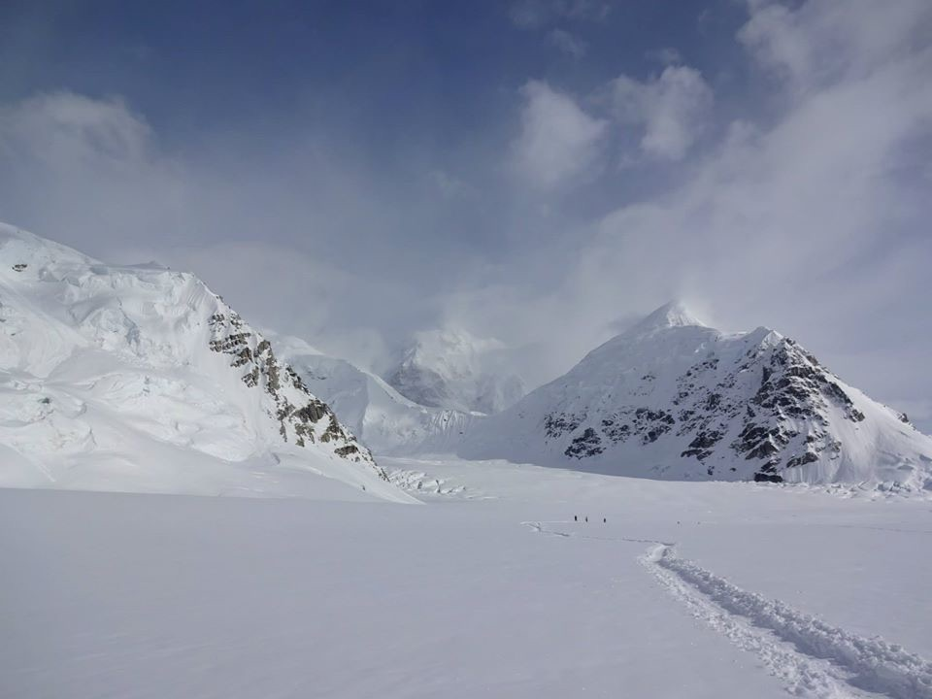

Slide 49
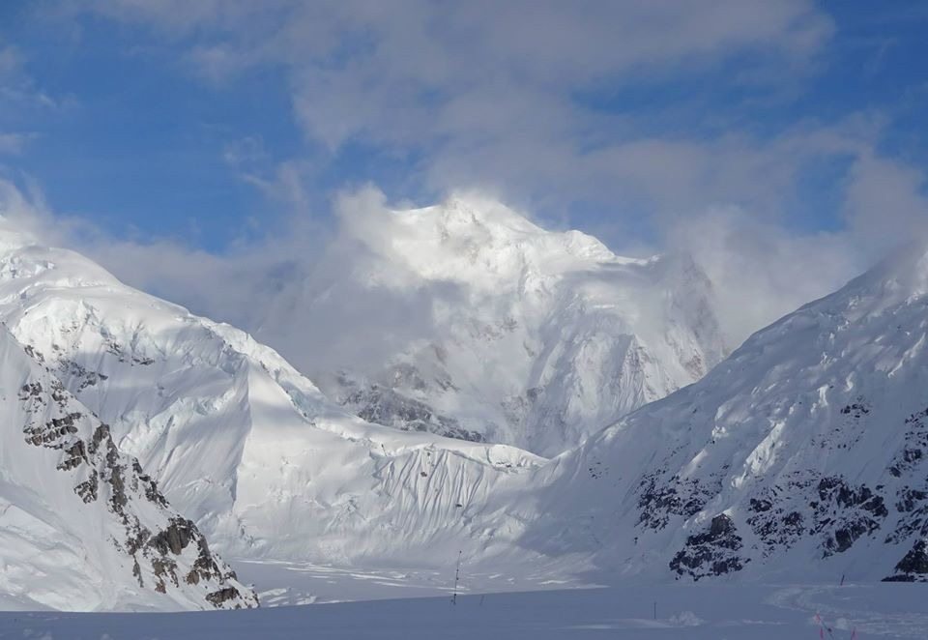

Slide 50
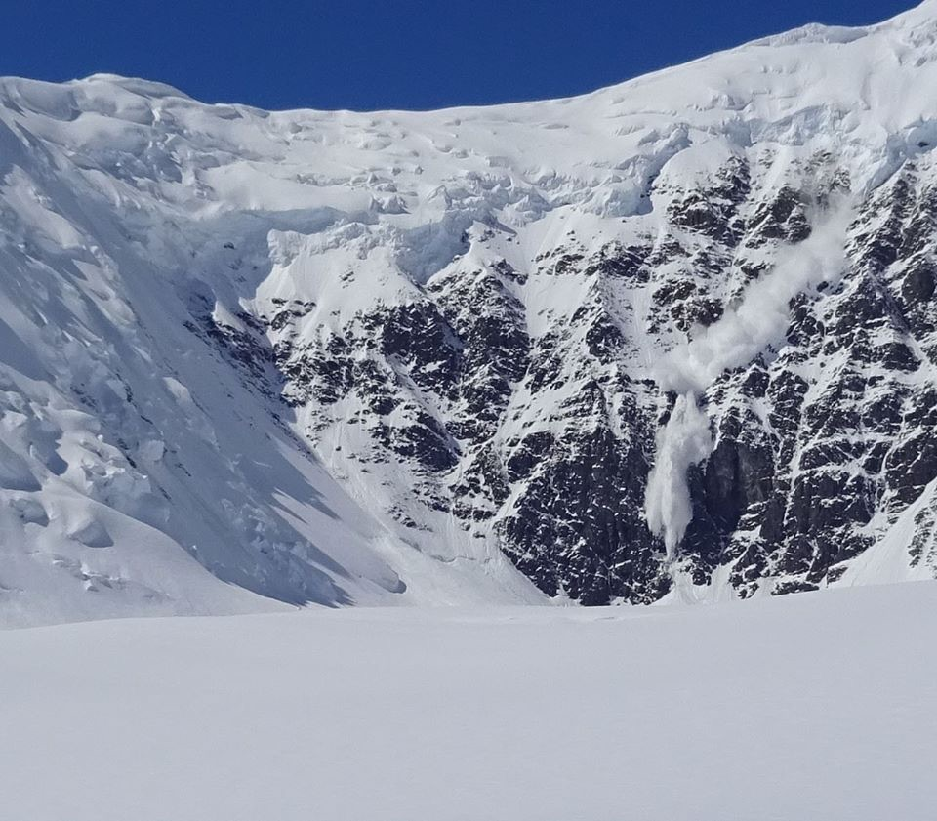

Slide 51
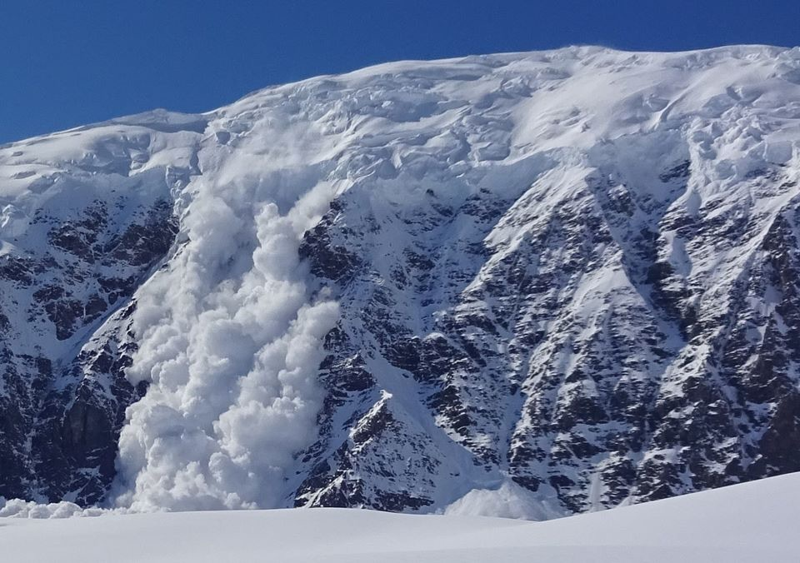

Slide 52
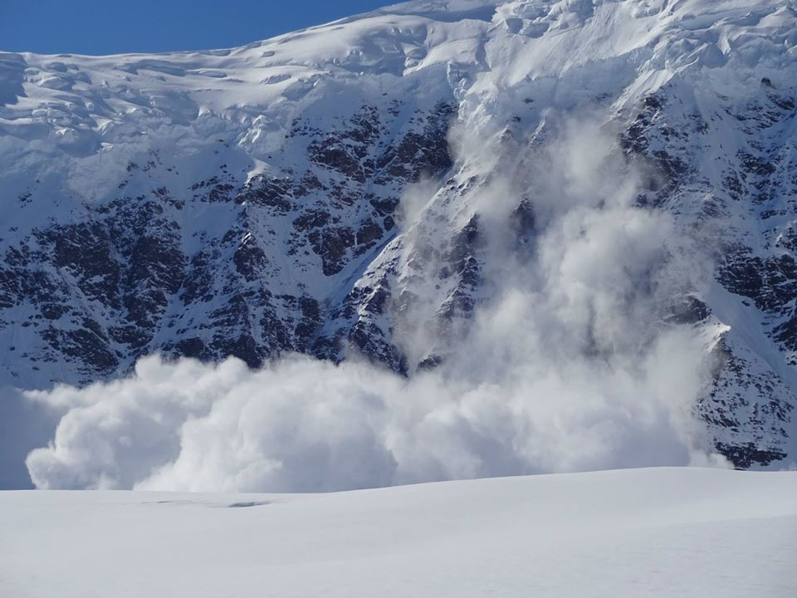

Slide 53
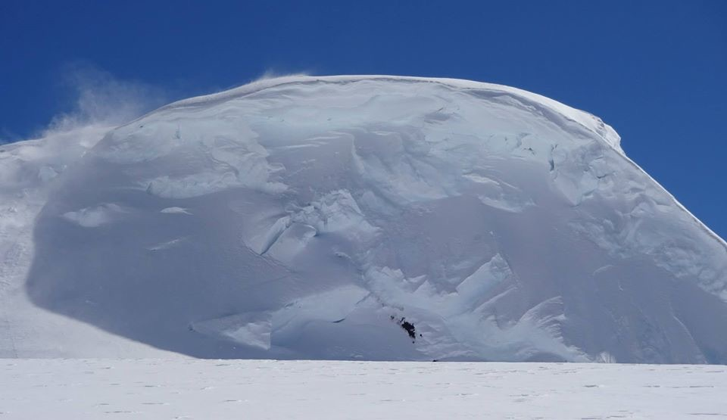

Slide 54
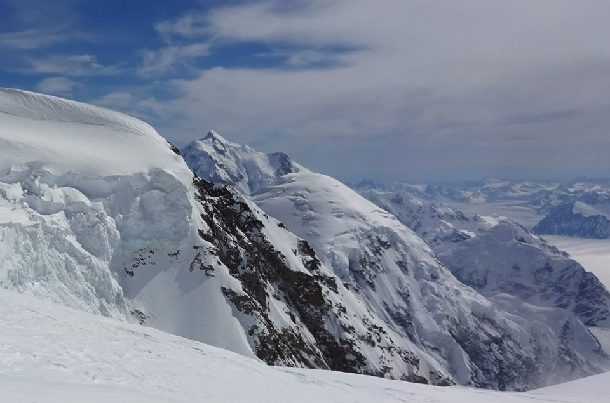

Slide 55
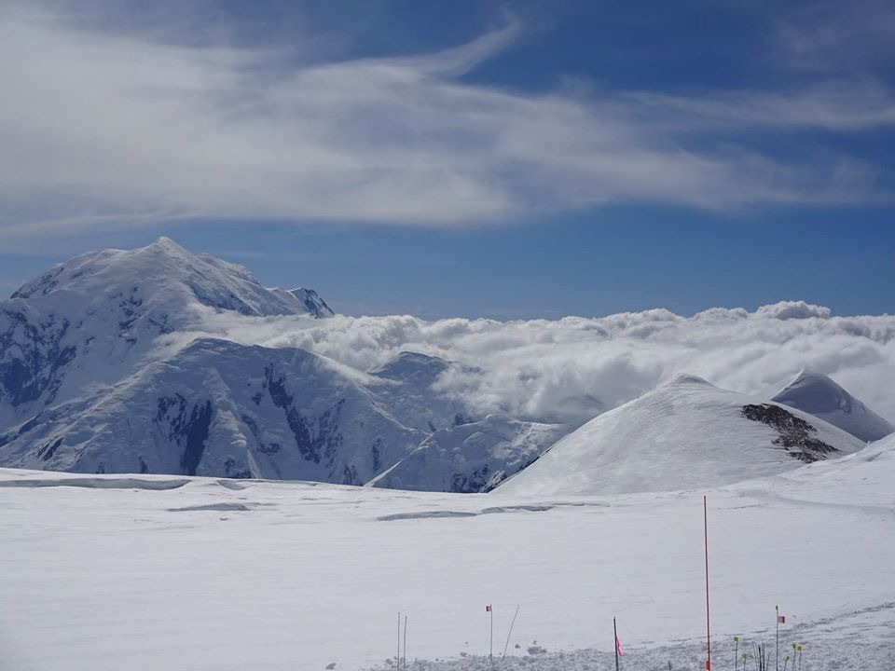

Slide 56
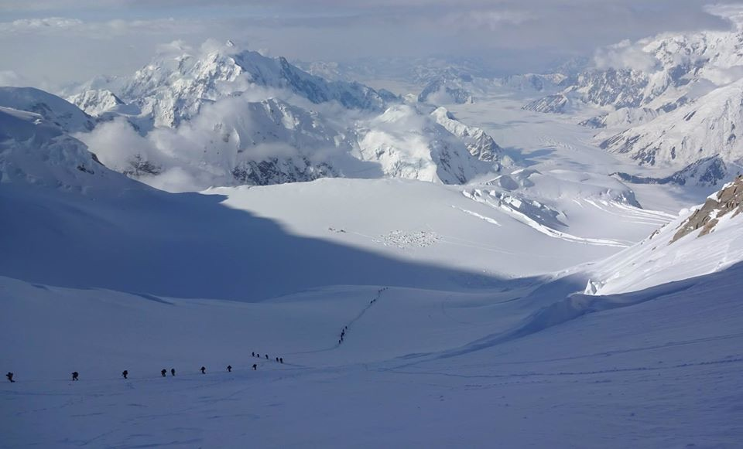

Slide 57
