Slide 1
Colonial Society in the 18th Century
Chapter 4 & 5
I Can discuss the following essential topics:
From servitude to slavery in the Chesapeake region
Resistance to colonial authority: Bacon’s Rebellion, Glorious Revolution, and the Pueblo Revolt
Religious diversity in the American colonies
The Enlightenment and the Great Awakening
Religious diversity in the American colonies
Transatlantic trade and growth of seaports
The 18th century back country
Population growth and immigration

Slide 2
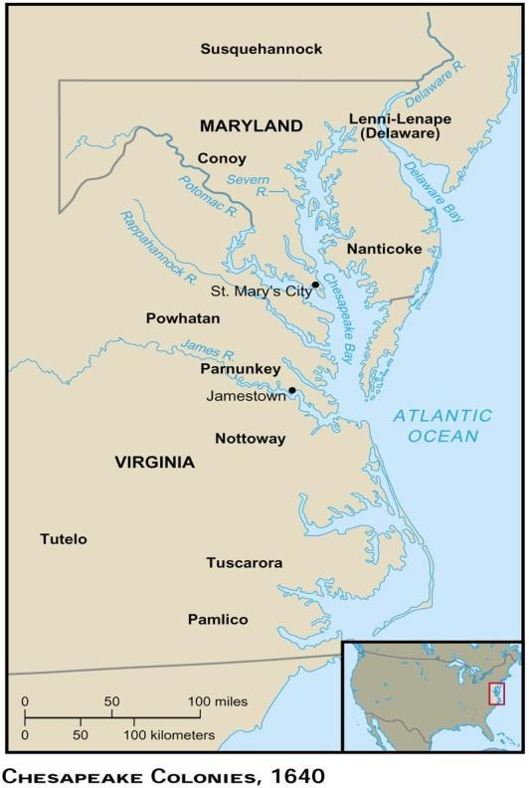
The Unhealthy Chesapeake
Diseases ravaged the people in the Chesapeake
Malaria, Dysentery, Typhoid
Low Life Expectancy
50% of the people born did not live to their 20th b-day
Slow growth was the result
Growth was only achieved by immigration
Most immigrants died shortly after arrival
Mainly dudes…. Men outnumbered women 6 to 1 in 1650 and 3 to 2 by 1700
Very few families
Most marriages ended with a death of a spouse within 7 years
Few children reached adulthood with both parents; almost none knew a grandparent
33% of brides were pregnant when married

Slide 3
The Chesapeake Improves…
Native-born whites eventually developed immunities to diseases
More women come…. and by the late 1600’s white population is growing due to birthrate

Slide 4
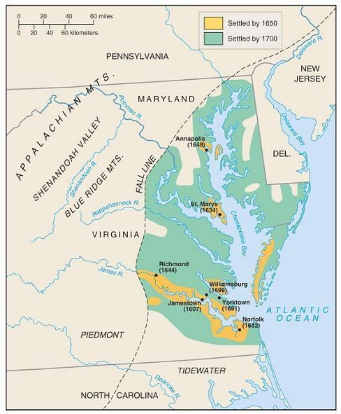
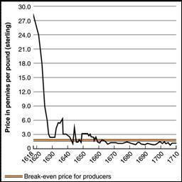
The Tobacco Economy
The Chesapeake is great for tobacco growing
However, tobacco is horrible for the soil and quickly depleted the soil
This forced settlers to move west and further encroach on Native Americans
Very labor intensive
Overproduction lead to a price crash
Farmers responded by growing more tobacco

Slide 5
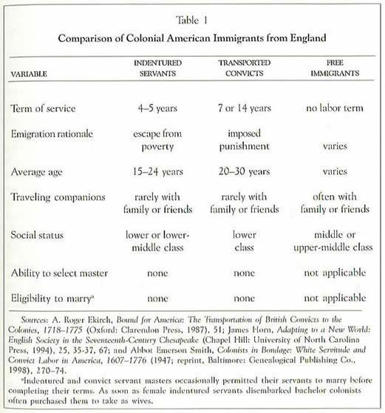
Indentured Servants and the Tobacco Economy
Indentured Servants: English farmers who gave years of labor in exchange for passage to the Americas
Solution to low birthrate
After time served they were supposed to get a chance to own their own land
Most stayed on the land (not a lot of success stories)
Land they did get was usually out on the frontier (Indian attacks were common)
Headright System encouraged indentured servitude (100,000 had come by 1700 or 75% of all immigrants)
Whoever paid for the passage of a laborer got 50 acres of land
Rich people amassed huge amounts of land

Slide 6
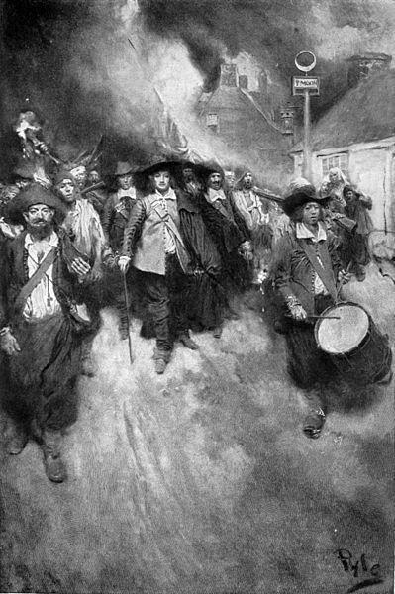
Bacon’s Rebellion, 1676
In the late 1600’s there were large numbers of young & poor men that didn’t have land or women
Bacon’s Rebellion was basically a small civil war
1,000 disgruntled men rebelled led by Nathaniel Bacon
They resented….
Lack of good land (and women)
No support from the gov’t in terms of protecting them from Indians
Gov. Berkeley refused to retaliate for Indian attacks
Actions of the Rebels
Attacked Indians (friendly or not)
Drove the Governor out of Jamestown and burned the city
Plundering
Bacon died suddenly of disease and the rebellion is quickly crushed

Slide 7
Colonial Slavery
Colonial Slavery Basics
1st slaves introduced in 1619 in Jamestown
By 1670 slaves numbered 2,000 (out of 35,000)
Slavery picks up in the 1680’s
English wages increased which led to a decrease in immigration and a shortage in labor
Bacon’s Rebellion scared many wealthy landowners
Slaves were easier to control
Fewer revolts
New York (1712)
Stono Rebellion (1739)
American merchants (especially in Rhode Island) participate in the slave trade
By the mid 1700’s slaves came to outnumber whites in Southern colonies
A black culture, distinctive from American and African culture developed
Gullah, a blend of English and several African languages, was a unique language developed on the islands of South Carolina

Slide 8
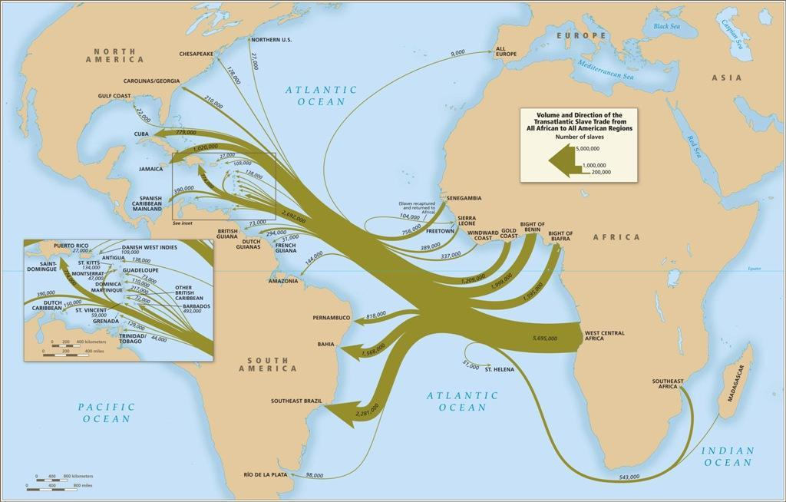
Atlantic Slave Trade

Slide 9
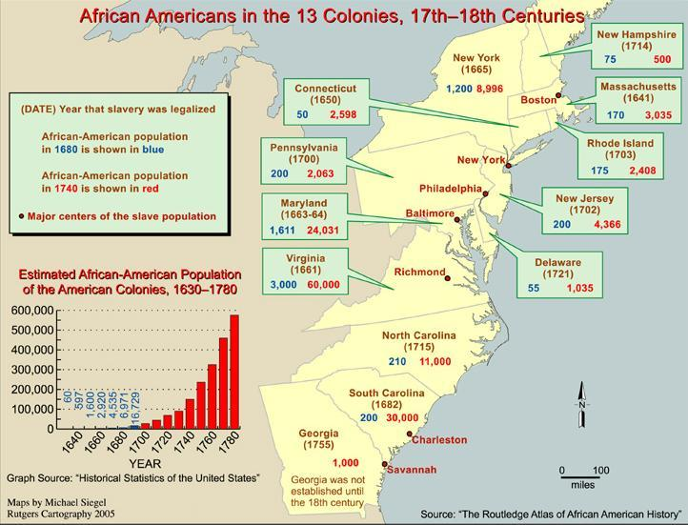

Slide 10
Slavery and Racism
In mid 1600’s slavery became a racial institution
In the early 1600’s, the differences between slaves and servants were unclear
In 1662, “slave codes” were adopted
Made blacks (and their children) property (chattels) for life
Became a crime to teach a slave to read or write
Conversion to Christianity did not matter

Slide 11
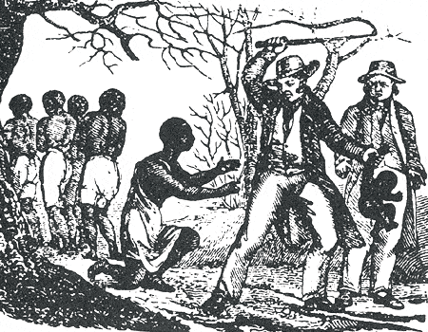
Deep South Slavery v. Chesapeake Slavery
Deep South Slavery
Rice & Indigo
Physically demanding
Slaves worked to death
No slave families
Slave population increased only through fresh imports
Chesapeake Slavery
Tobacco
Less physically demanding
Slave families
Slave population increased naturally

Slide 12
Southern Society
Owned huge plantations and slaves. Dominated social and political life. Very wealthy.
Plantation Life
Life revolved around plantation
Few Southern cities
Very few roads
Elite White Planters
White Farmers
Usually former indentured servants. Worked on farms or trades for low wages
Landless Whites
Indentured Servants
Even though there numbers were declining by the late 1600’s
Slaves
Slaves were the lowest with no hope of freedom
Small farmers who owned small land and may have had a slave or two. Lived a poor lifestyle.

Slide 13
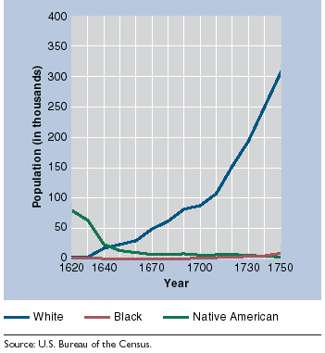
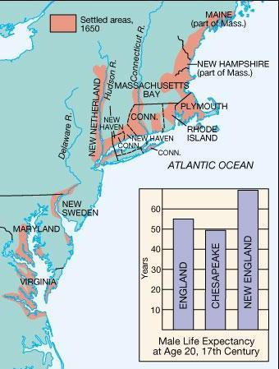
New England Basics
New England Population
Climate less deadly than south
Cooler weather and clean water = less disease
10 more years of life expectancy compared to England
Puritans tended to migrate as families
Families had many children
Women typically bore children every 2 years until menopause
Women came to fear pregnancy
Strong family structure produced healthy adults and strong social structure
Led to a strong/peaceful society
Low premarital birth rate

Slide 14
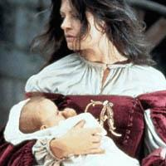
More on the New England Family
Integrity of Marriage
Divorce was rare
Adultery or abandonment
Adulterers were publicly whipped and forced to wear a capital letter “A” on their clothing for the rest of their lives

Slide 15
New England Women
Southern women’s rights were more advanced
Men died at young ages often
Women inherited the property and thus had more rights and power
New England views on women
New England women gave up property rights upon marriage
Women were morally weaker (Bible)
Could not vote
Obey the husband (laws were in place against abusive husbands)
Some women worked as midwives, but most were housewives

Slide 16
Life in the New England Towns
Tight-knit societies
Puritans were encouraged to all watch out for the moral health of all others
Expansion of settlement was orderly in New England compared to the Chesapeake
New towns had to be legally chartered by colonial authorities
Distribution of land and town planning was done by the town fathers
Towns were set up similar
Church and the Town hall were surrounded by houses and there was also a village green where the militia would train
Town hall meetings
Each family had several pieces of land
Woodlot, land for crops, and pasture
Towns with more than 50 families were required to provide elementary education
50% of adults were literate
Harvard College established in 1636 to train local boys for the ministry

Slide 17
The Half-Way Covenant
Half-Way Covenant: religious zeal among 2nd generation Puritans began to wane
This covenant allowed 2nd generation Puritans to join the church as partial members, but not full members
Baptism, but no Communion
Religious purity is sacrificed for more participation
Jeremiads, or strong calls to repentance were attempted to get Puritans to become more faithful

Slide 18
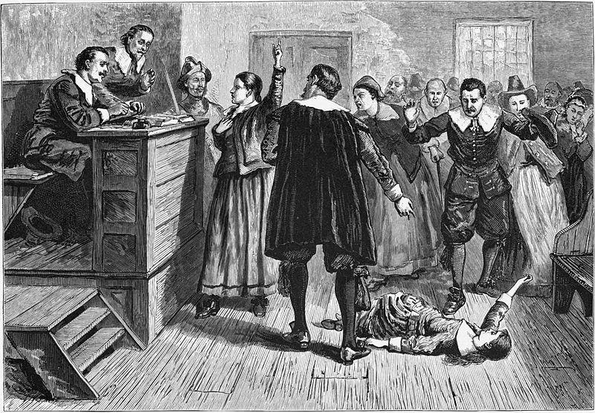
Salem Witch Trials
Began in 1692
Witch hunt ended with 20 women being executed
19 hanged, 1 pressed, and 2 dogs were also hanged
Causes of the Salem Trials
Superstitions of the time
Reflected the widening social stratification of New England and the fear of Puritanism being corrupted by commercialism
The accused came from families associated with Salem’s growing market economy
The accusers came from farming families
Ends in 1693
Families of the executed were given reparations and their convictions were annulled

Slide 19
New England Way of Life
Difficult farming led to back-breaking work led to a strong character
Less ethnically diverse than any of the other colonies
No cash crops
Little reason for slavery
Contrasting view of land
Indians saw the right to use the land, but not own it
The English condemned Indians for wasting land
Believed it was duty to improve the land
Rich cod stock in the ocean made many New Englanders fisherman, shipbuilders, and merchants

Slide 20
The Importance of New England
New Englanders spread throughout America and influenced others
Yankee ingenuity came to be part of the entire nation known for its can-do-attitude
High idealism inspired later reformers
City on top of the hill

Slide 21
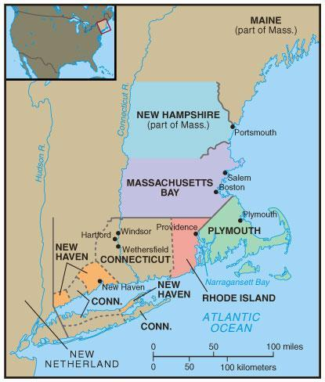
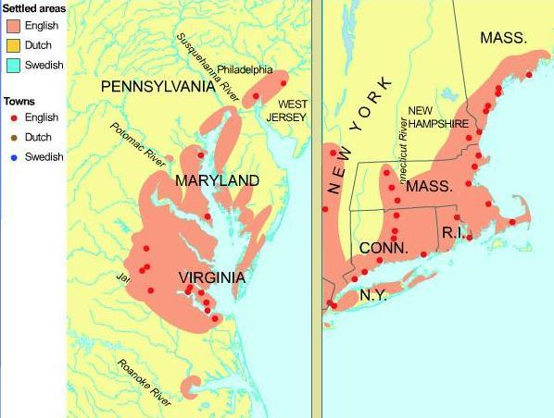
Characteristics of 18th Century British Colonial America (BCA)
Enormous population growth—common
Demographic changes result in a shift in the balance of power between BNA and England
1700=less than 300,000; 1775 2.5 million (20% black)
High fertility rate
Largest colonies: VA, Mass, Penn, NC, Maryland
Four major cities: Philadelphia, NY, Boston, Charleston
90% lived in rural area in early 18th century; 80% by American Revolution

Slide 22
18th Century Immigration
America as a melting pot: The “Old Immigration”
Most mixed population
90% of slaves lived in the South
NE least ethnically mixed
Middle colonies most ethnically mixed
Outside NE about ½ of pop. Non-English in 1775
Population breakdown 1790
English and Welsh 66%
African 20% by 1775 mostly in South
Scots Irish and Highlanders 5.6%
German 4.5%
Dutch 2%
Irish 1.6%
French .4%
All other withes .3% (Swedes, Jews, Swiss)

Slide 23
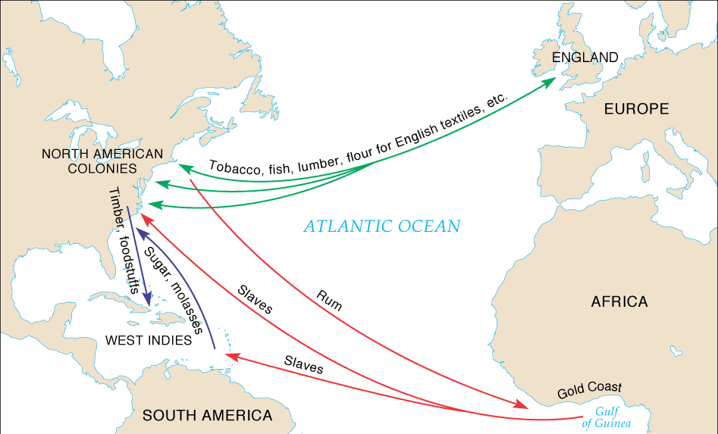
18th Century Commerce and Trade
Triangular trade (illegal trade designed to circumvent Navigation laws)
Land speculation
Manufacturing
Transportation
Shipbuilding

Slide 24
18th Century Social Structure
Structure of Colonial Society--Stratification emerged by mid 18th century; not as much prior to 1750
On average, Americans had the highest standard of living in the world
Upper Class
Yeoman Farmers
Lesser Tradesman, Manual Workers, Hired Hands
Indentured Servants & Criminals
Slaves

Slide 25
The Great Awakening 1730’s-40’s
1st mass social movement in American History
Spread principally throughout the middle and southern colonies
Main issue was religious style: personal faith, church practice and public decorum
Many found sermons boring and too elaborate
Jonathan Edwards and George Whitefield got people excited and challenged to the old clergy
Increased number of Christian denominations
Sparked the founding of
Princeton
Brown
Rutgers
Dartmouth

Slide 26
18th Century Religion
Americans were not big church goers
Even the Puritans struggled to maintain church membership
Different religious groups
Anglican Church
Congregational Church
Presbyterian Church
Quakers

Slide 27
18th Century Education
New England
Major point of focus
Too be a better Christian people had to read the Bible
Middle Colonies
Benjamin Franklin helped found the University of Pennsylvania (1st non-religious college)
South
School systems were impractical due to the lack of towns and cities
Private tutors
Higher Education
Originally set up to train better priests

Slide 28
Culture and the Press
Most Americans too busy working to survive to spend time on art
Notables
Phillis Wheatly (African-American poet)
Ben Franklin
Only respected scientist/academic from colonies
Poor Richard’s Almanac
Artists had to travel to Europe for proper training
Weekly newspapers played a big role in colonial life

Slide 29
Colonial Politics
Structure of Colonies
Royal Colonies
Proprietary Colonies
Charter Colonies
Bicameral legislature most common
Nature of American politics
50% white male suffrage
Religious and land requirements

